Slide 1
Welcome to the District 9 Service Workshop

Slide 2
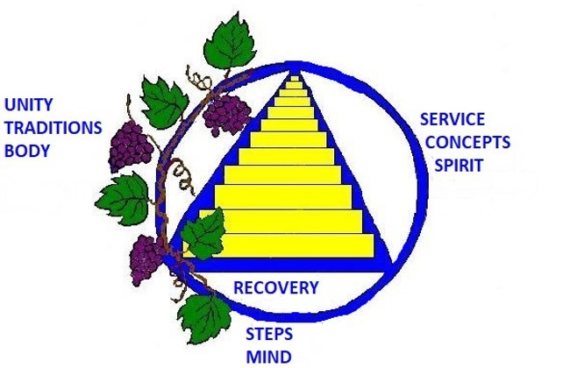

Slide 3
A Brief Timeline of Our Three Legacies
1934 Dec. 11 Bill W. gets sober
1935 June 10 Dr. Bob gets sober and AA is founded
Aug. 11 The Alcoholic Foundation created as trusteeship
April The book Alcoholics Anonymous published (1st Legacy- Recovery)
1946 April Grapevine prints “Twelve points to Assure Our Future”
1950 July 1st Intl. Convention in Cleveland, Traditions adopted (2nd Legacy- Unity)
Conference of Delegates proposed,
1951 April Panel One of the GSC meets in NYC with 37 States & Provinces present
The Alcoholic Foundation renamed the General Service Board
2nd Intl. Convention in St. Louis
Panel 5 of GSC also St. Louis, a Resolution adopted that the GSC would
replace the co-founders and responsibility of future affairs turned over
to the Fellowship. Bill W. states AA has come of Age
Legal Bylaws for GSB created
1962 Concepts are adopted and published, (3rd Legacy- Service)

Slide 5
Materials reprinted with permission from AAWS
Not for reproduction or sharing to the general public

Slide 7
“By choosing its most qualified member as G.S.R.
a group helps secure its own future---and the
future of A.A. as a whole”
From the G.S.R. pamphlet

Slide 8
The strength of our whole A.A. service structure starts with the group and with the general service representative (G.S.R.) the group elects. I cannot emphasize too strongly the G.S.R.’s importance.
- Bill W.

Slide 9
What does a GSR do?

Slide 10
General Services:
Attend district meetings
Attend area assemblies
Elect area officers
Elect Conference delegate
Elect District Officers
Attend Delegate’s Report and share info with group

Slide 11
Group Services:
Group contact*
Guardian of the Traditions
Tradition 7 Champion
Disseminate news & information
Get Familiar with AA literature
Encourage homegroup members to participate on
District committees *new GSR’s download GSR Kit

Slide 12
In Your GSR Kit:
The A.A. Group
The A.A. Service Manual / Twelve Concepts for World Service
Inside A.A.
Circles of Love and Service
A.A. Tradition - How It Developed
Self-Support: Where Money and Spirituality Mix

Slide 13
Other Helpful Information:
Twelve Steps and Twelve Traditions
A.A. Comes of Age
The Twelve Traditions Illustrated
The Twelve Concepts Illustrated
Final Conference Report
A.A. Guidelines
VAC Newsletter (Spring, Summer, Fall)
Box 459 from GSO
Traditions & Concepts Checklists

Slide 14
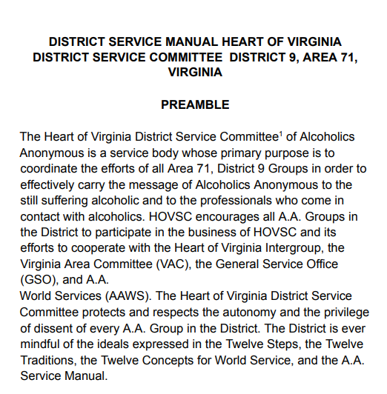
District & Area Service Manuals Available to Download aaheartofva.org aavirginia.org
Page 1 / 37
Zoom 50%
Page 1 / 37
Zoom 50%
Jefferson District Service Manual
Preamble
The Jefferson District Service Committee of Alcoholics Anonymous is a service body whose primary purpose is to coordinate the efforts of all Area 71, District 9 Groups in order to effectively carry the message of Alcoholics Anonymous to the still-suffering alcoholic and to the professionals who come in contact with alcoholics. JDSC encourages all A.A. Groups in the District to participate in the business of JDSC and its efforts to cooperate with the Jefferson District Intergroup, the Virginia Area Committee (VAC), the General Service Office (GSO), and A.A. World Services (AAWS). The Jefferson District Service Committee protects and respects the autonomy and the privilege of dissent of every A.A. Group in the District. The District is ever mindful of the ideals expressed in the Twelve Steps, the Twelve Traditions, the Twelve Concepts for World Service, and the A.A. Service Manual.
May also be referred to as the JDSC, District 9, or the District.

Slide 15
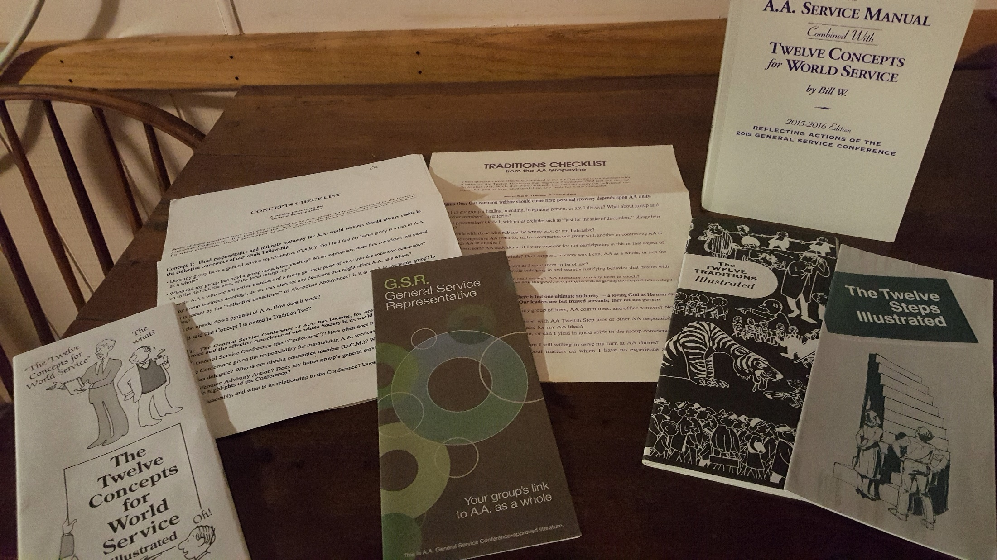

Slide 16
GLOSSARY
A.A.W.S. –AA World Services
Advisory Action-decision by GSC
Area- In Virginia the entire state
Assembly-Gathering of VAC for business and elections
Conference Approved Literature-made by AA
Convention-Usually Fellowship event, VAC held annually, International every 5 years
CPC- Cooperation with Professional Community, committee to help those that work with alcoholics
Delegate- Elected rep to GSC
Director-a servant on the corporate board of AAWS or Grapevine
District-divisions in an area
DCM- District Committee Member,
Elected to facilitate District meetings and serve on assigned Area Committee
GSB- General Service Board
GSC-General Service Conference
GSO-General Service Office
Grapevine- Our Magazine, Meeting in print and online
Group-A meeting that is based on our 12 Traditions, listed with GSO and participates in general service
GvR – Grapevine rep
H & I – Hospitals & Institutions
Intergroup-(Central Office)Handles local AA business ,sells literature, prints meeting schedules, answers local phone inquiries
La Vina -Spanish version of Grapevine
Meeting-gathering of alcoholics, also VAC event to plan Assemblies
PI – Public Information
Region-Group of several Areas
Rotation – spiritual principle of sharing responsibility by changing leadership
Trustee- member of the GSB
VAC- Virginia Area Committee

Slide 17
Financial Support
Your homegroup should provide financial support for you to attend two assemblies each year.
Hotel
Travel (39¢/mile)
Food ($40/day)
Money available from district for one night’s lodging if your group can’t fund
Funds also available from VAC if District
monies unavailable

Slide 18
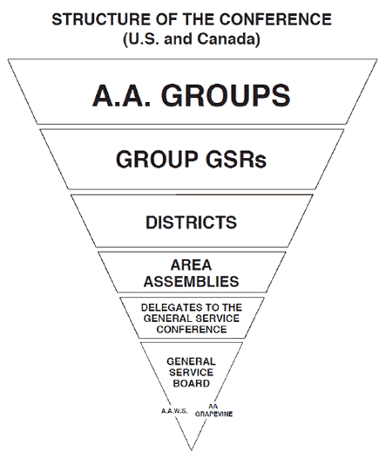

Slide 19
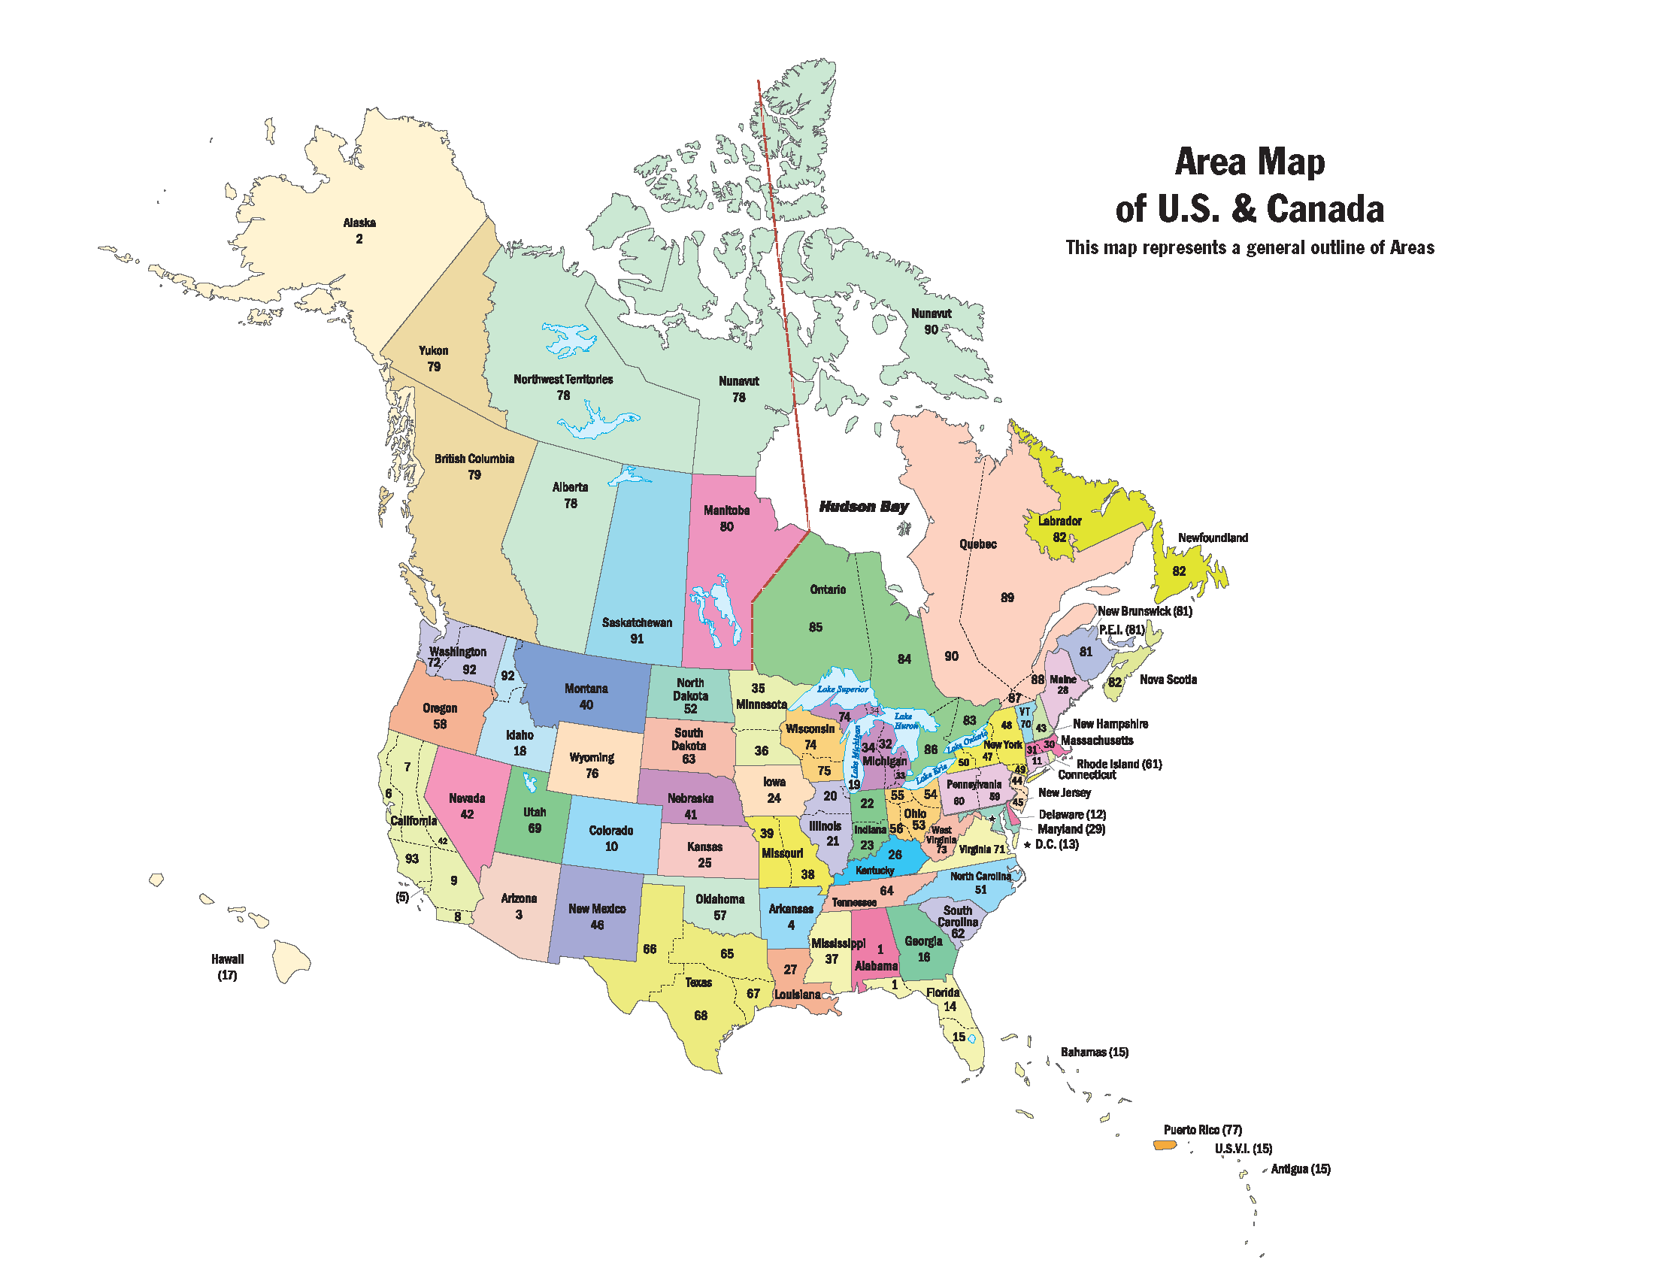
93 Areas

Slide 20
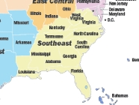

Slide 21
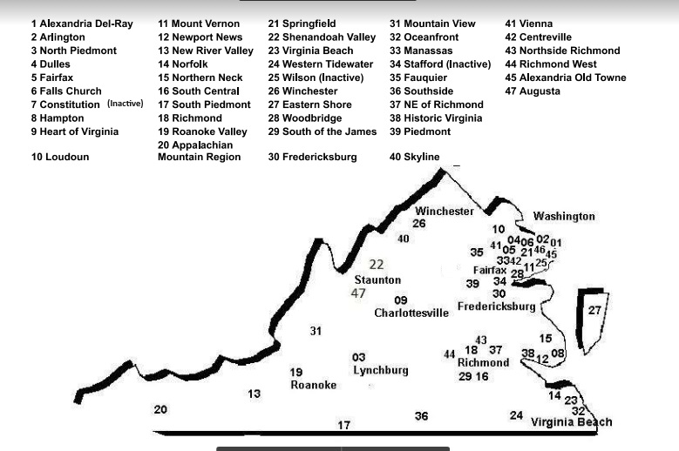
Area 71
46 Districts

Slide 22
Heart of Virginia District 9

Slide 23
AA’s Responsibility Declaration
I am responsible. When anyone, anywhere, reaches out for help, I want the hand of AA always to be there. And for that: I am responsible.

Slide 24
AA’s Declaration of Unity
This we owe to AA’s Future; To place our common welfare first; To keep our Fellowship united. For on AA unity depend our lives, and the lives of those to come.

Slide 25
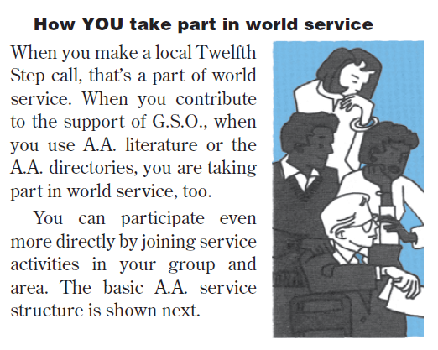

Slide 26
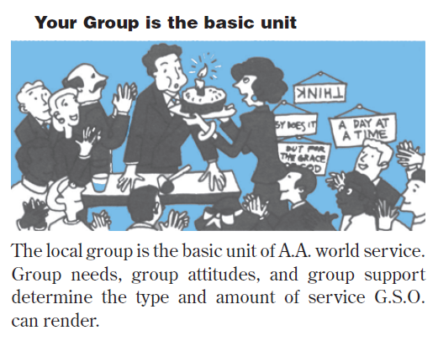

Slide 27
Suggested Steps to Achieving an Informed Group Conscience
GATHER KNOWLEDGE: The GSR or other chairperson of the group informs himself/herself about the topic to be discussed. Then:
PRESENT TOPIC/ISSUE: Present the information on the topic to the home group, giving enough background material so all participants are informed on both sides of the topic. The chairperson should be as unbiased as possible on the topic.
SHARING: Ask each member to share in turn, being sure to allow all to share once before anyone shares a second time. Remember, this is not a general discussion meeting. It is a method of arriving at unanimity on a specific subject. Remember to carefully listen to any minority opinions.
CONSENSUS: Continue the process until substantial group unanimity is achieved. This is usually considered 2/3 of the participants. More than one sharing session may be needed. Remember, you are striving for a group conscience, not a “popular vote.” Be patient and practice AA principles as the process continues.
RECAP: Once a group conscience is achieved, present a summary of their conscience to the group as a whole including minority opinion. Pass the group conscience and any minority opinion on to the appropriate person(s), be it the Delegate, Area Committee, or District.

Slide 29
District Committee
Officers: DCM District Committee Member
ADCM Alternate District Comm. Mem.
Secretary
Treasurer
Committee Chairs: Archives, Cooperation w/Intergroup, Cooperation w/ Professional Community-Public Information, Corrections, Finance & Budget, Grapevine, Hospitals & Institutions,
CHARYPAA Rep,
GSR’s

Slide 30
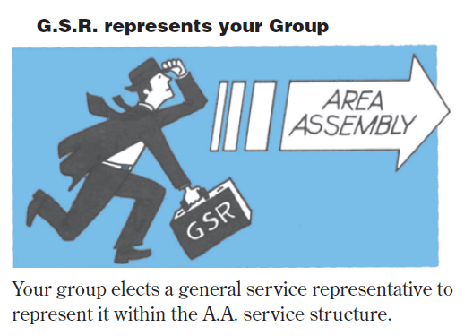

Slide 31
Area assemblies are held twice a year in the Spring and Fall. The Area Committees meet at this time, workshops are held, Area business is conducted, In the Spring, Conference Concerns are discussed so our Area Delegate can take the conscience of the Area to the General Service Conference. Some include a guest speaker. Every 2 years elections are held to select a Delegate and other Officers. Assemblies include GSR’s ,DCM’s Area Officers, Committee Chairs and Special Assignment Coordinators. Summer and Winter Meetings are held where the committees meet and the agenda for Assemblies are formed that include the DCM’s Area Officers, Area Committee Chairs, and Special Assignment Coordinators

Slide 32
VAC ( Virginia Area Committee)
Delegate & Alternate Delegate
Officers- Chair, Alternate Chair, Secretary, Treasurer
Committee Chairs-Accessibilities,Archives, Conventions,
Cooperation w/Intergroup,
Cooperation w/ Professional Community, Correctional Facilities, Finance & Budget, Grapevine & Literature, Growth, Public Information, Treatment Facilities, Website
Special Assignment Coordinators-Archivist ,Arrangements,
Mail List, Newsletter Editor,
Sound Engineer, Website, Information Technologies
(And Ad hoc committee as created when necessary)

Slide 34
Why Do We Need a Conference?
The late Bernard B. Smith, nonalcoholic, then chairperson of the board of trustees, and one of the architects of the Conference structure, answered that question superbly in his opening talk at the 1954 meeting: “We may not need a General Service Conference to ensure our own recovery. We do need it to ensure the recovery of the alcoholic who still stumbles in the darkness one short block from this room. We need it to ensure the recovery of a child being born tonight, destined for alcoholism. We need it to provide, in keeping with our Twelfth Step, a permanent haven for all alcoholics who, in the ages ahead, can find in A.A. that rebirth that brought us back to life.
“We need it because we, more than all others, are conscious of the devastating effect of the human urge for power and prestige which we must ensure can never invade A.A. We need it to ensure A.A. against government, while insulating it against anarchy; we need it to protect A.A. against disintegration while preventing over-integration. We need it so that Alcoholics Anonymous, and Alcoholics Anonymous alone, is the ultimate repository of its Twelve Steps, its Twelve Traditions, and all of its services.
“We need it to ensure that changes within A.A. come only as a response to the needs and the wants of all A.A., and not of any few. We need it to ensure that the doors of the halls of A.A. never have locks on them, so that all people for all time who have an alcoholic problem may enter these halls unasked and feel welcome. We need it to ensure that Alcoholics Anonymous never asks of anyone who needs us what his or her race is, what his or her creed is, what his or her social position is.”

Slide 37
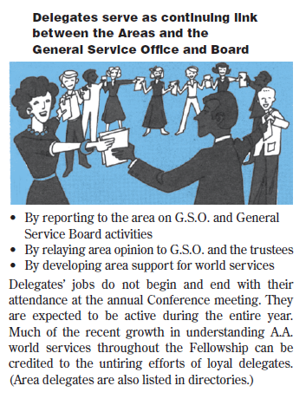

Slide 38
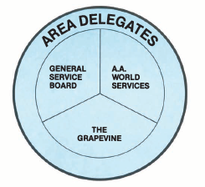
The annual General Service Conference is held every year in April. Our elected Delegate represents us there.

Slide 39
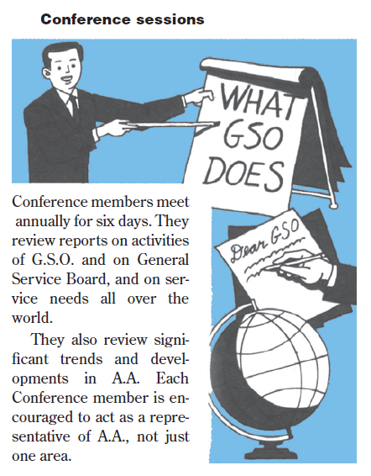

Slide 40
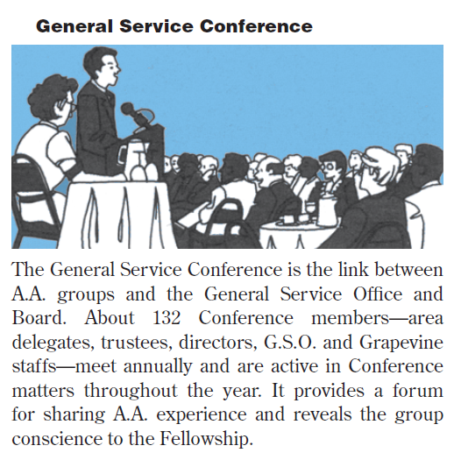

Slide 41
Conference Committees :
Agenda
CPC (Cooperation with Professional Community)
Corrections
Finance
Grapevine
Literature
Policy/Admissions
PI (Public Information)
Report & Charter
Treatment & Accessibilities
Trustees
Secondary Committees:
International Conventions/Regional Forums
Archives

Slide 42
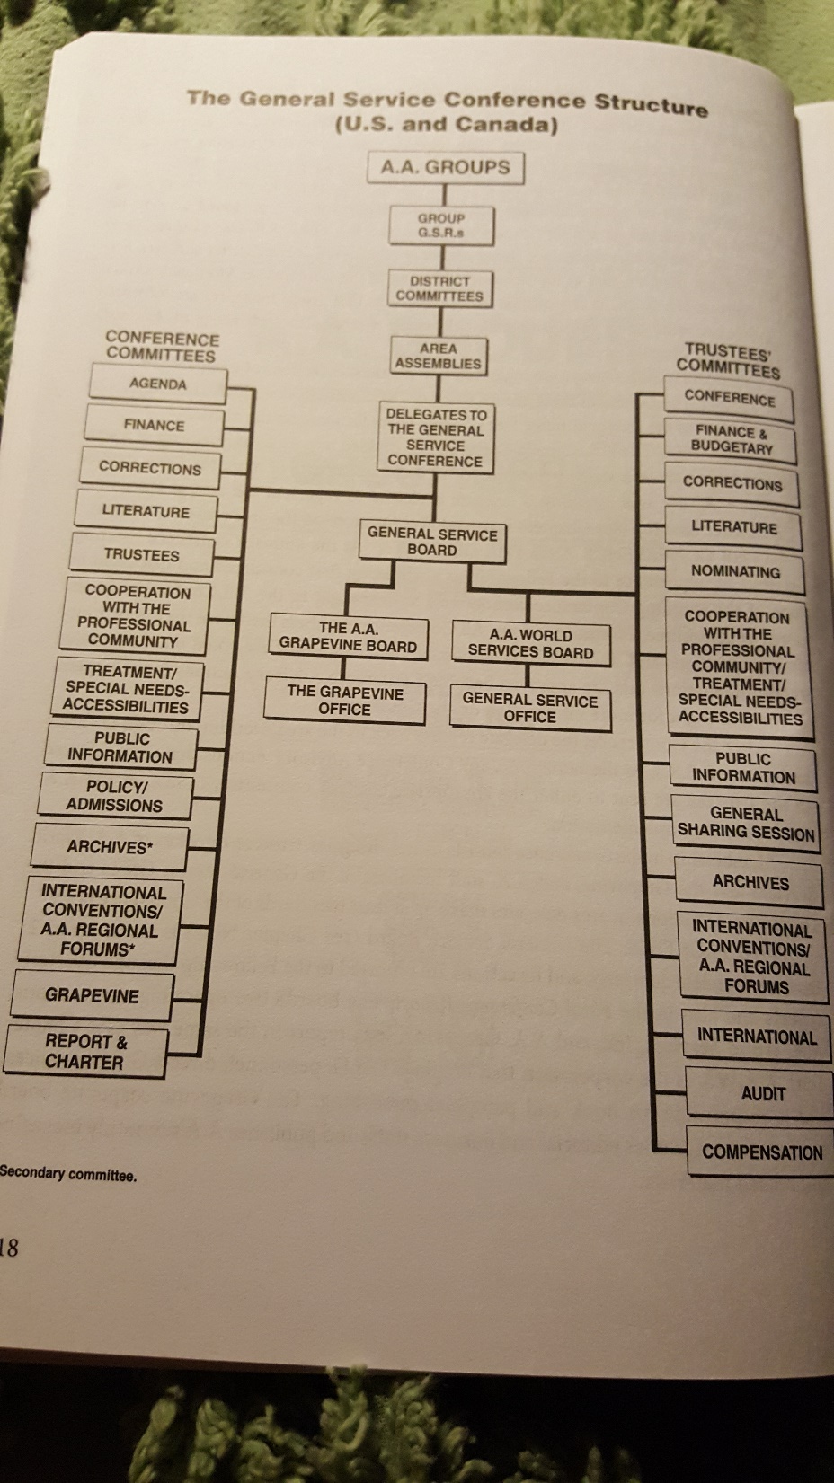
Page S18 of our
A.A. Service Manual

Slide 43
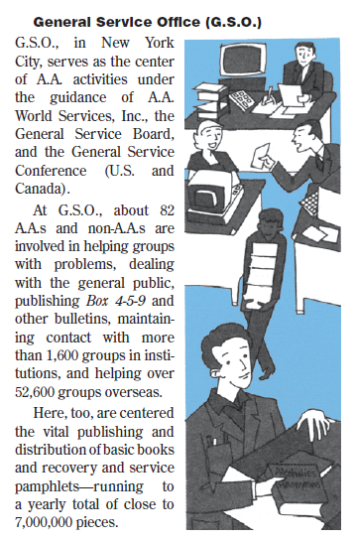

Slide 44
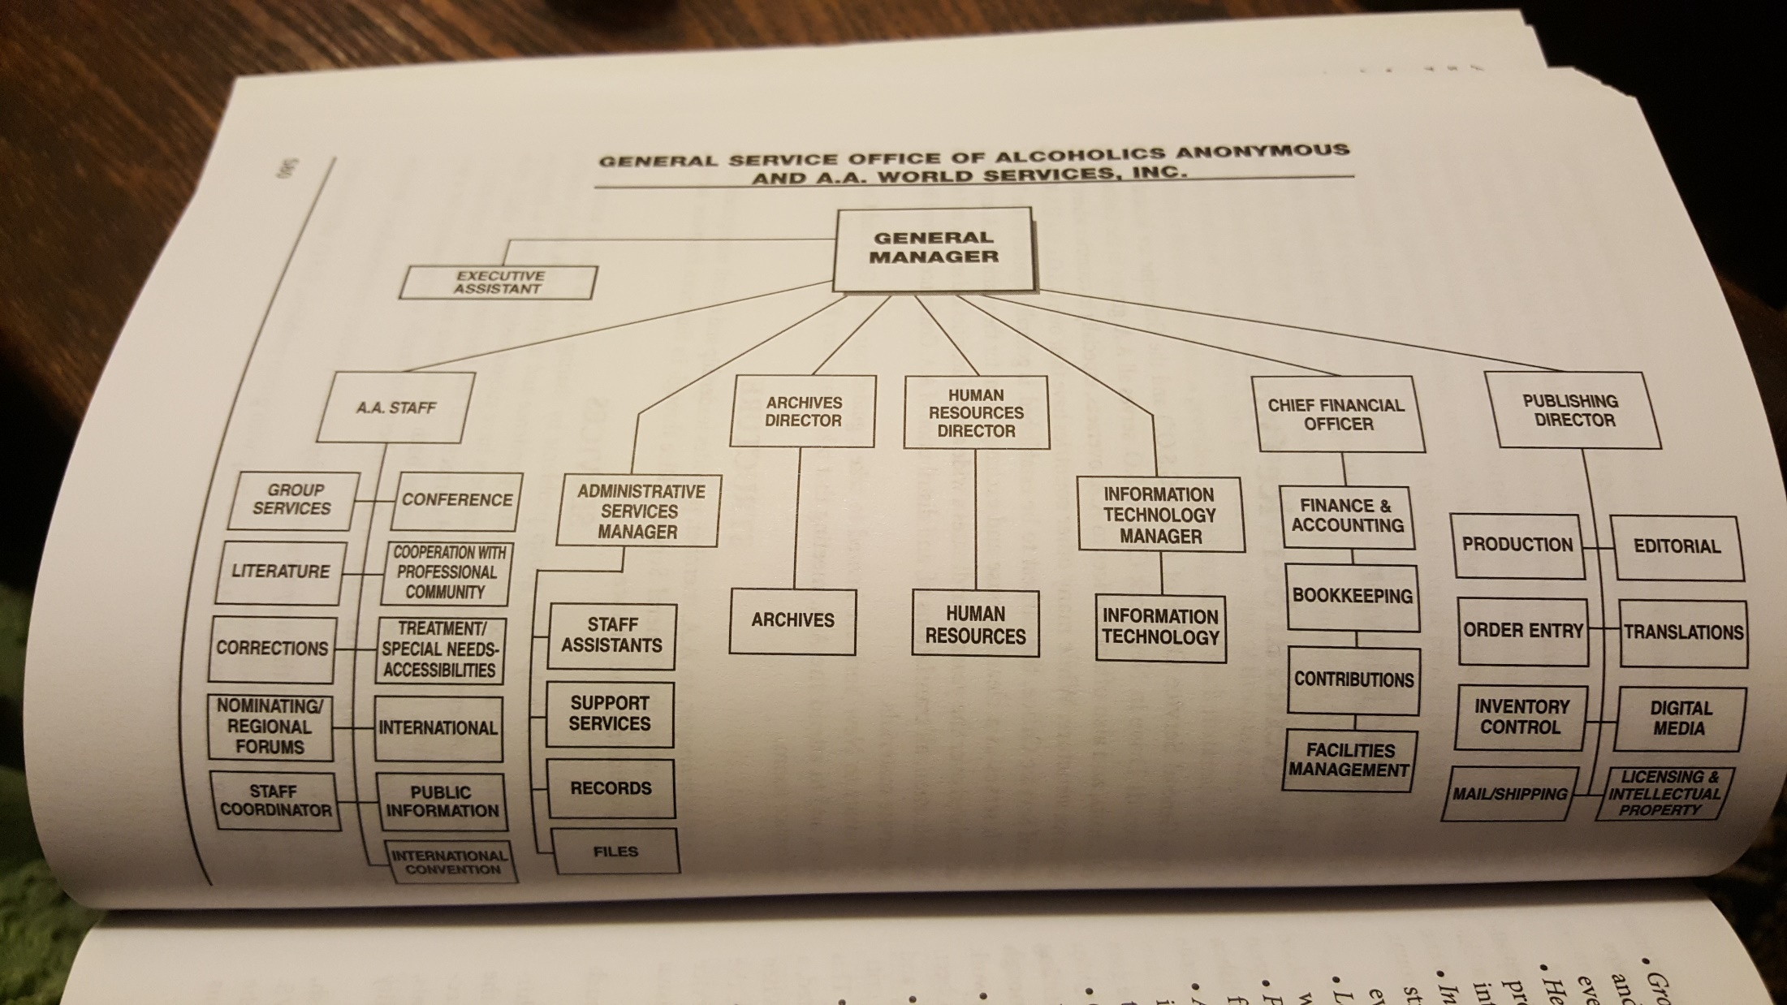
Page S80 The A.A. Service Manual

Slide 45
Who is in Charge at G.S.O.?
No one person or group of persons is "in charge," although the general manager carries out primary responsibility for day-to-day operations and is assisted by other administrative officers and the General Service Office staff. Staff members at each service desk are themselves recovering alcoholics. Other employees may or may not be recovering alcoholics.

Slide 46
A.A. World Services, Inc.(AAWS)
Oversees the General Service Office (GSO- New York) and its service activities in the U.S. and Canada. They publish and distribute our books, pamphlets and other items. They handle the day-to-day aspects of operation of AA’s business.

Slide 48
What Gets Done At Your General Service Office?
Working closely with committees of A.A.’s General Service Board, your General Service Office has broad responsibilities to its member groups. They include the following:
Collect, organize and pass along to A.A. groups and members throughout the U.S. and Canada the shared experiences on group challenges and solutions, when asked.
Work with alcoholics overseas, as well as Loners (A.A.s living in areas with no meetings); Homers (housebound or disabled members); Internationalists (seagoing A.A.s); A.A.s in the armed forces; and A.A.s in treatment and correctional facilities.
Answer numerous letters requesting information about A.A. and the help it provides for alcoholics.
Publish the A.A. newsletter, Box 4-5-9, and other bulletins.

Slide 49
What Gets Done At Your General Service Office? (continued)
Distribute A.A. books and pamphlets approved by the General Service Conference and published by A.A. World Services
Provide complimentary literature and a Group Handbook to each new group that gets listed with G.S.O.
Coordinate and support the work of our General Service Conference committees.
Publish group Directories to help A.A. groups and individuals with Twelfth Step work.
Disseminate public information at the national and international levels for A.A. as a whole - cooperating with the print and electronic media as well as with organizations concerned with the treatment of alcoholism.
Produce and distribute audiovisual materials.
Maintain A.A. Archives.
Maintain the General Service Office website.

Slide 50
In 2017:
The General Service Office (GSO) responded to more than 90,000 emails and letters
The Contributions area received over 73,000 pieces of mail.
The Corrections desk answered over 6,500 letters (17 letters per day, every day).
Archives received over 1,300 requests for information and research.
8 million books, pamphlets & audio materials were shipped.
1,020 new AA groups in the U.S. and Canada were listed at GSO.
The website (www.aa.org) received over 1,000 visits a day for "Need Help With A Drinking Problem" and 3,000 online requests per month for media and press information about AA.
The website received over 12 million visits.

Slide 51
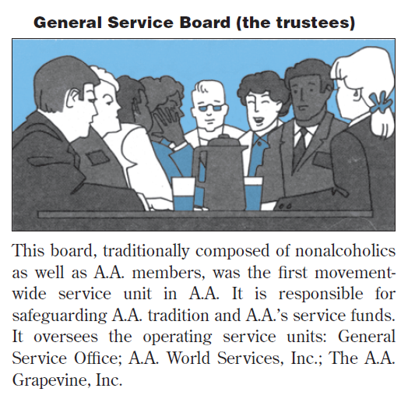

Slide 52
There are 21 trustees, 14 Class B, alcoholic and 7 Class A, non-alcoholics. They are concerned with everything happening in and out of AA that effects the health and growth of our movement. They do much of their work through the 2 operating corporations, A.A.W.S., Inc. and A.A.Grapevine, Inc. Class A’s serve for 2 consecutive 3 year terms and because they don’t have to maintain their anonymity, can represent us publicly. Class B’s serve 4 consecutive annual terms

Slide 53
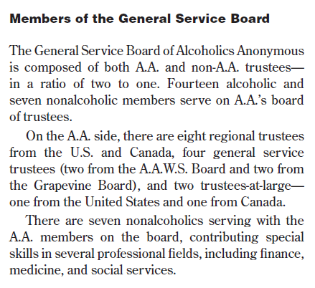

Slide 54
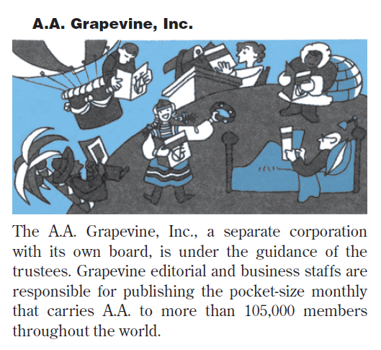

Slide 55
Who is in Charge at the A.A. Grapevine?
At the Grapevine, the executive editor oversees the publication of the magazine, circulation, customer service, and the day-to-day operation of the office.

Slide 56
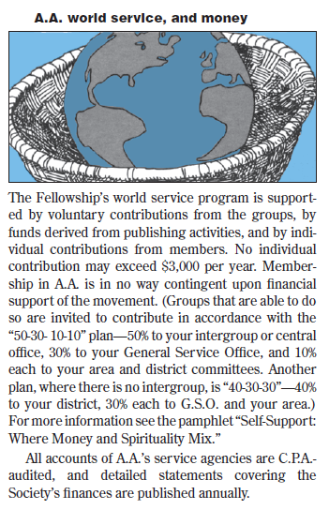
Now $5,000

Slide 57
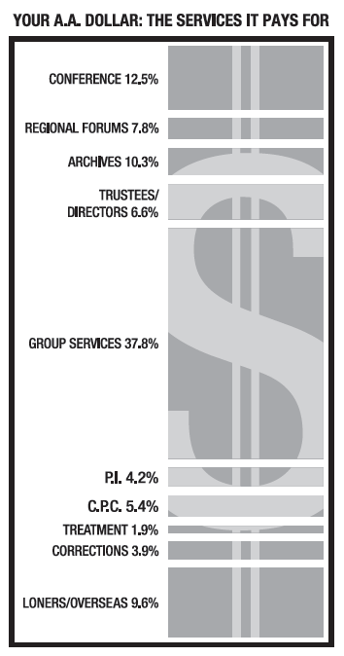
(2005)

Slide 58
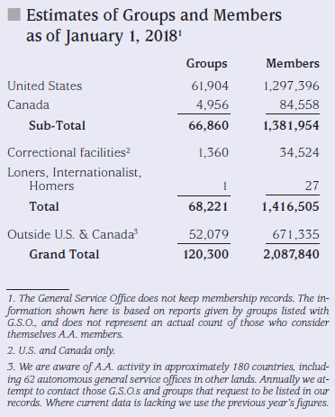

Slide 59
Suggestions for GSR at Home Group Meetings
Guardian of the Traditions – know where to find answers.
Give regular reports to the group regarding the district, the area and GSO.
Share information from GSO, such as Box 459, literature price lists, etc.
Explain issues to be voted on and find out how the group wants you to vote on matters of importance to all of AA.
Be the group contact for the area committee and GSO for AA directories, etc.
Ensure your group is offering all the sobriety tools available, including conference-approved pamphlets and books.
Seventh Tradition – work with your group treasurer to develop contribution plans.
Be familiar with The AA Service Manual, Twelve Steps and Twelve Traditions, Circles of Love and Service, The AA Home Group pamphlet.
Supply the DCM with up to date group information.
Write down questions and comments from group members and bring to district meetings and area assembly meetings.

Slide 60
Suggestions for GSR at District Meetings
Bring up for discussion issues or concerns from your group
Take information back to your group
Bring a notebook and a planning calendar
Update Group and GSR information with DCM
Get copies of reports and flyers to share with your group
Report what is happening at your group-events planned
Bring “Change for Change/Pink Can” and group contributions for District to the Treasurer

Slide 61
Suggestions for GSR at Area Assemblies
Vote on issues affecting A.A.
Elect area officers
Bring notebook, pen, and calendar
Bring group conscience to assemblies
Understand right of decision
Consider getting a Service Sponsor
When going “to the mike” state whether you are in favor or against the issue you are speaking to,2minute limit, Not necessary to
restate a view already shared
Review Roberts Rules & 3rd Legacy Voting

Slide 62
Roberts Rules of Order
(Guide to orderly business meetings)
How to make motions
How to amend or reword motion
Point of order, when there is a mistake in procedure
Calling the question ,to end discussion and have a vote
All must be heard before same person speaks second time

Slide 63
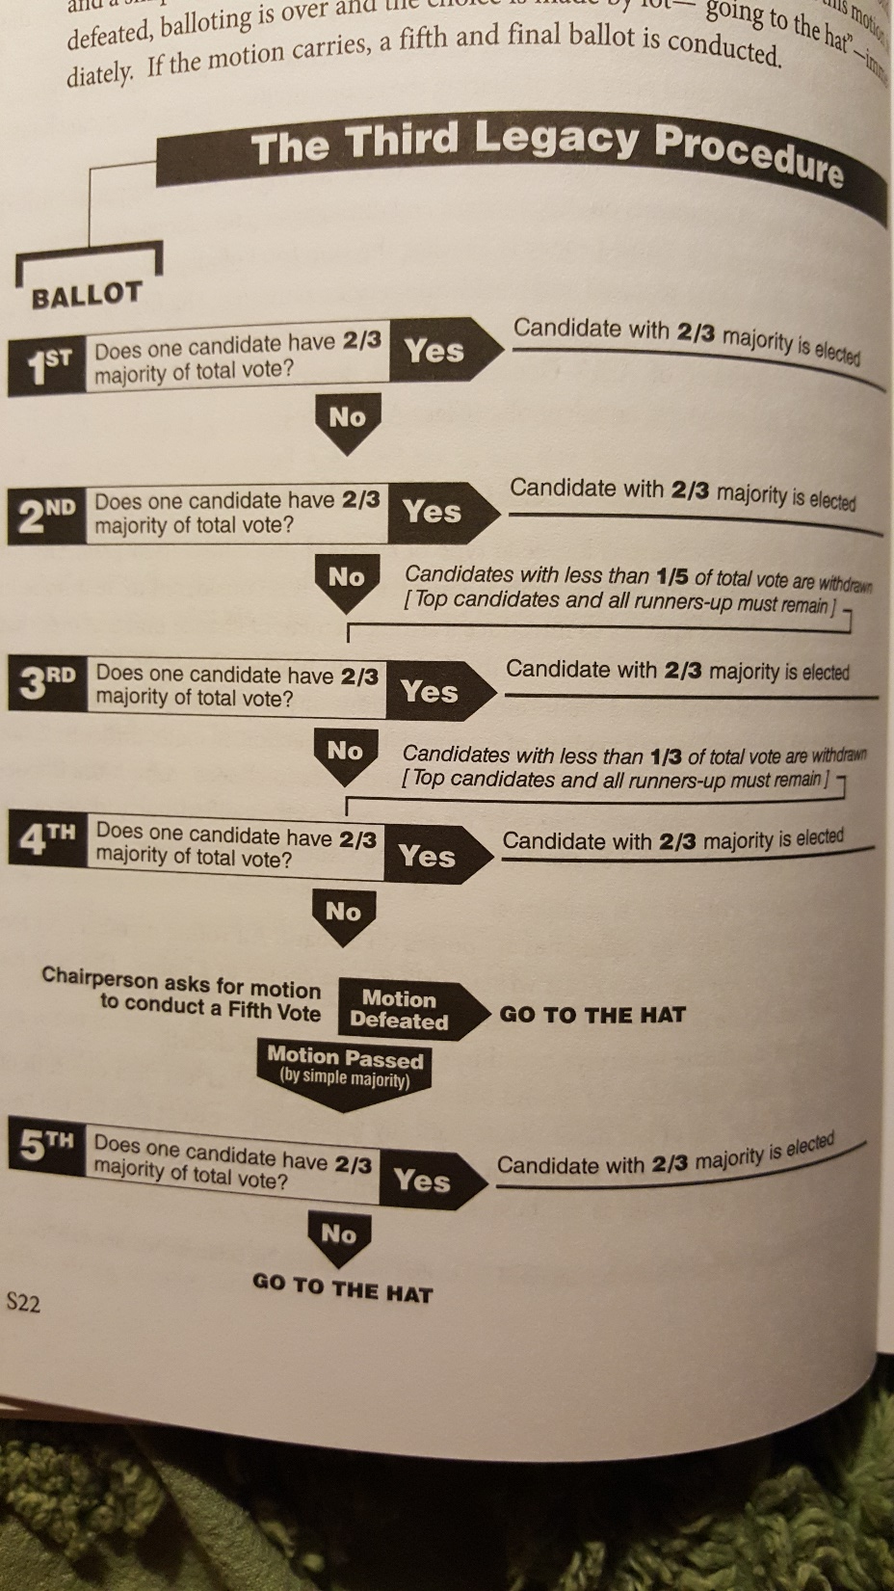
Page S22
The A.A. Service Manual

Slide 64
Twelve Concepts for World Service
(Principles to guide our Services, A Study Summary)
1st says we all have a voice, inclusion, communication and is rooted in Tradition 2
2nd reinforces 1st, the upside down triangle, the GSC represents the group to maintain and grow world services
3rd Right of Decision ,trust our trusted servants, how to interpret and apply authority and responsibility to each problem or situation as it arises, Stand up for yourself
4th Right of Participation, Inclusion, No bosses or 2nd class, equality, Tradition 2 again
5th Right of Appeal, don’t rush into decisions ,All have a voice, minority opinion has a duty to speak
6th Upside down triangle again, GSC insures our primary purpose can continue and take care of business, “pay the bills”

Slide 65
7th Balance of authority and responsibility, Conference makes recommendations and Board carries those out
8th Management of services, more balance, delegation of duties and responsibilities
9th Good leadership, an ever vital need, lead by example not mandate, trusted servants again
10th Structure, balance, clarity, each operational responsibility
must be accompanied by a corresponding authority ,again Tradition 2, careful definitions and mutual respect
11th Composition, functions, and responsibilities of the committees of GSB, GSO and Grapevine. Shared leadership, Spirit of Rotation, Compensation for paid workers
12th General Warranties 1. The Conference shall never become the seat of perilous wealth or power. 2. Sufficient operating funds, plus an ample Reserve ,should be its prudent financial principle.

Slide 66
3.None of the Conference members shall ever be
placed in a position of unqualified authority over any of the others.
4.All important decisions should be reached by discussion, vote
and wherever possible, by substantial unanimity.
5. That no Conference action shall ever be personally punitive or an incitement to public controversy .
6. That though the Conference may act for the service of Alcoholics Anonymous, it shall never perform any acts of government ; and that, like the Society of Alcoholics Anonymous which it serves, the Conference itself will always remain democratic in thought and action.
“Freedom under God to grow in His likeness and image will ever
Be the quest of Alcoholics Anonymous. May our General Service Conference be always seen as a chief symbol of this cherished liberty”

